Slide 1
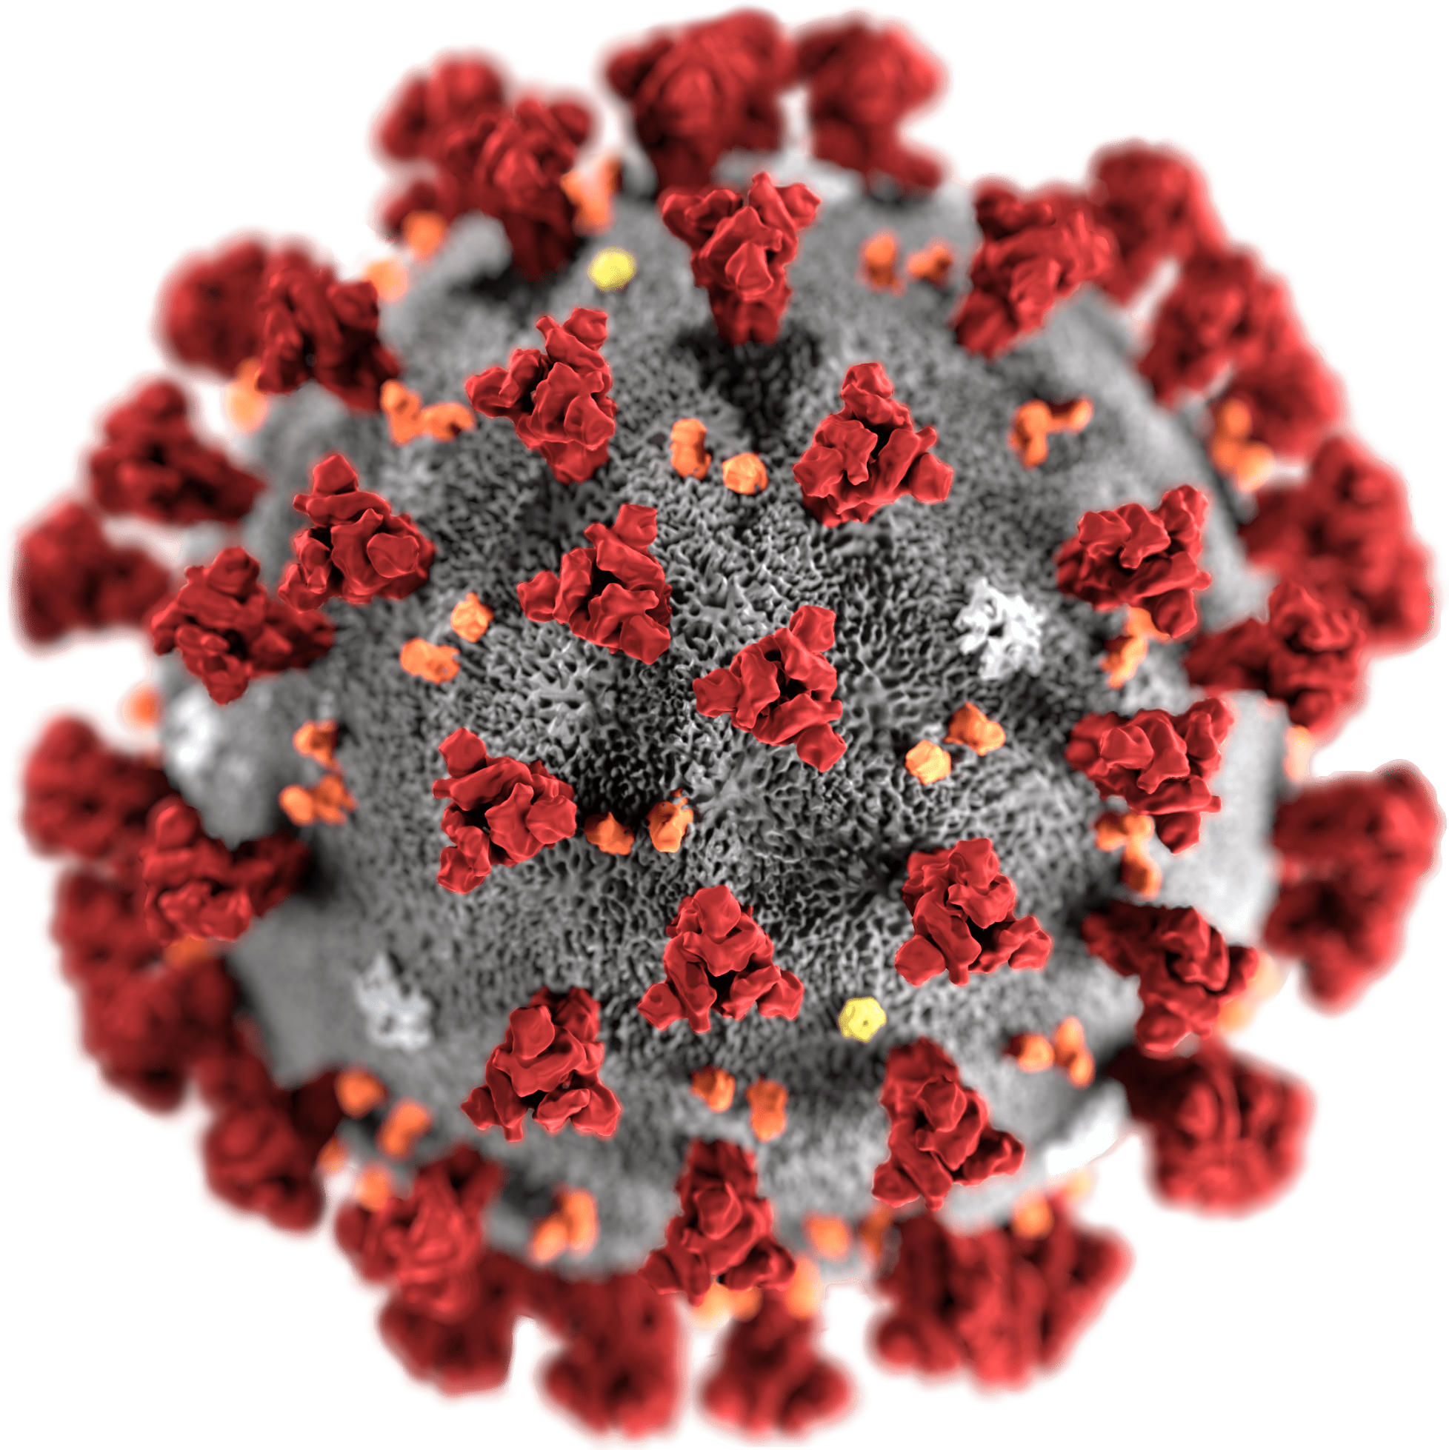
COVID-19 SARS-CoV-2 Lisa Gilbert, MD, FAAFP, CTropMed 3/17/20

Slide 2
COVID-19 SARS-CoV-2 2019-nCov HCoV-19
Disease
Virus Name

Slide 3
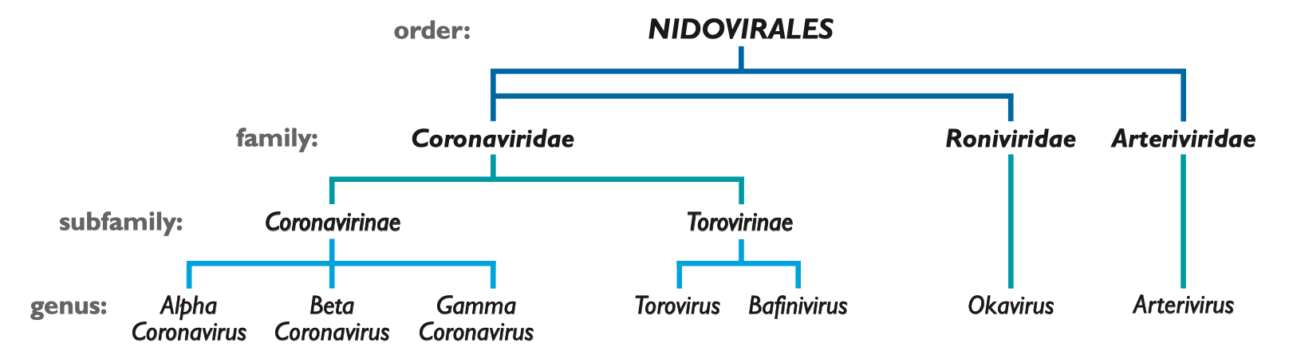
7 Human Coronaviruses: 4 normal; 3 “novel”
Alpha: HCoV-229E, HCoV-NL63 Beta: HCoV-HKU1, HCoV-OC43, MERS-CoV, SARS-CoV, SARS-CoV-2

Slide 4
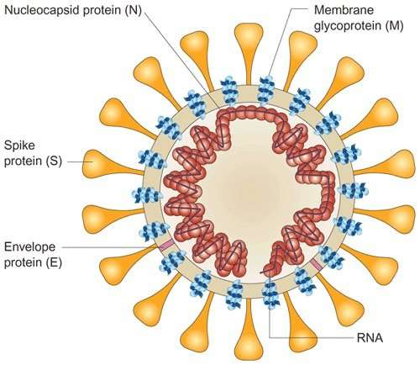
Coronavirus Structure
Medium-sized virus size, but largest mRNA genome
Enveloped +ve stranded RNA
mRNA encased in nucleocapsid
Lipid Bilayer – Soap works to disrupt this!
Corona = Crowns for Spikes
Glycoprotein Spike (S) Peptomer
Spikes allow it to attach to human cell receptors in upper or lower airway

Slide 5
Coronavirus Genome
Encodes four or five structural proteins:
S – spikes on the outside; mediates receptor binding
M – membrane protein; assists viral assembly
N – nucleocapsid protein; regulation of viral RNA synthesis, may interact with M protein during virus budding
E – small envelope protein; function necessary but not fully understood
HE – hemagglutinin-esterase glycoprotein in Beta coronavirus OC43 and HKU1 only; enhances uptake into mucosal cells
Video and article on how coronavirus replication in cells occurs: https://www.youtube.com/watch?v=Eeh054-Hx1U
https://www.ncbi.nlm.nih.gov/pmc/articles/PMC4369385/

Slide 6

Myth 1: Donald Trump Named it Coronavirus
Fake news!

Slide 7
Upper Respiratory Infections
Normal human coronaviruses cause 5-10% of common cold/URIs, with outbreaks to 30% of common cold
229E and NL63 (alpha coronaviruses)
OC43 and HKU1 (beta coronaviruses)
These four predominately attach to receptors in UPPER airway (receptors: aminopeptidase N, dipeptidyl peptidase 4)
Seasonality unpredictable (generally winter, but persists year round), different pattern in tropics than temperate regions
URI symptoms, croupy or dry cough, rarely pneumonia (except sometimes NL63, but usually just causes croup); Mild diarrhea in infants
Don’t forget other URI viruses: Rhinovirus, Influenza A/B, Adenovirus, Parainfluenza, Respiratory syncytial virus, Human metapneumovirus

Slide 8
“Novel” Coronaviruses
Novel coronaviruses predominantly in LOWER respiratory tract
SARS, MERS, SARS-CoV-2
Don’t forget other LRIs:
Viral Pneumonia: Influenza (A/B), Adenovirus, Parainfluenza (Type 1-4), Respiratory syncytial virus, Human metapneumovirus, NL63
Typical bacteria CAP: Lobar – Streptococcus pneumoniae, Staphylococcus aureus, Haemophilus influenzae, Moraxella catarrhalis; Gram neg, anaerobic if aspiration
Bacterial bronchitis or atypical CAP: Bordetella pertussis, Mycoplasma pneumoniae, and Chlamydia pneumoniae
SARS (2002-2003): Contained. CFR 10%. >50% mortality in >60 years.
MERS: Not Contained. CFR 35%. Linked to direct camel exposure.
High healthcare worker infection and other nosocomial spread
Aerosolization during procedures (intubation, nebs, BiPAP, suctioning)

Slide 9
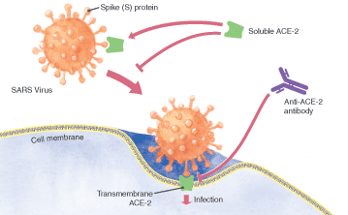
Novel CoV attachment
ACE-2 Receptors
Type 2 alveolar cells - highest
Bronchial epithelia
Tongue > buccal epithelia
Upper Intestinal epithelia
Myocardial cells
Kidney proximal tubule cells
Bladder urothelial cells
SARS-CoV-2 binds to ACE-2 Receptor 10-20x more strongly than SARS-CoV
Question of ADEs (Antibody Dependent Enhancement)
Antibodies can create a backdoor enhancement for viral replication
Implications on viral replication and vaccine development safety
https://www.nature.com/articles/s41368-020-0074-x
https://jvi.asm.org/content/94/5/e02015-19

Slide 10
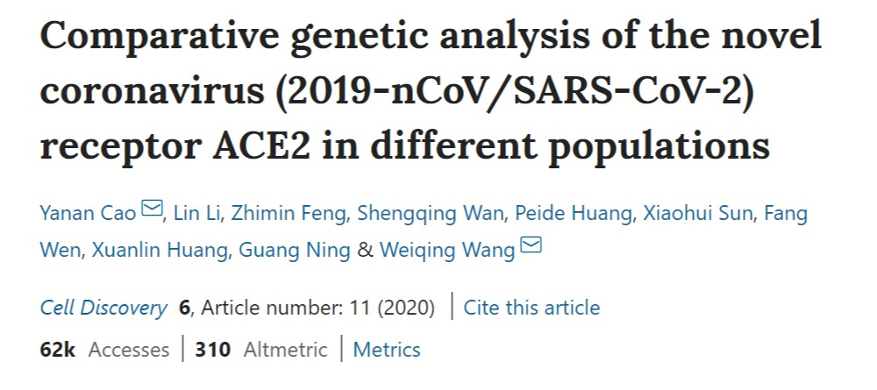
Myth 2: Only Asian Men Get Coronavirus
False.
Asian men MAY have higher numbers of ACE2 Receptors on Type 2 Alveolar Cells, but other studies refute this.
In any case, clearly everyone with ACE2 receptors is susceptible and you don’t have to be male or Asian to be infected.

Slide 11
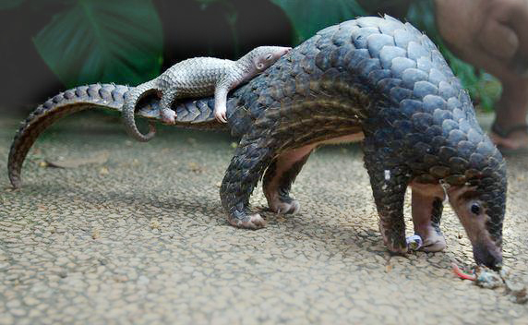
SARS-Cov-2 origin
Bat to a mammal (pangolin?) to human in Nov/Dec 2019
Pangolins used in Chinese medicine
Probable link to seafood/exotic animal market
Other plausible theory:
Wuhan Level 4 Biohazard lab experimental
animals sold for human consumption

Slide 12
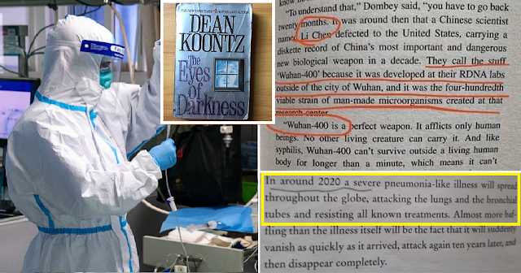
Myth 3: COVID-19 was predicted in 1981
False
…but really eerie coincidence
Notes:
Published 39 years ago.

Slide 13
SARS-Cov-2 Transmission
Novel: No herd immunity, No antibodies cross-reacting
Incubation 2-14 days (outlier 27 days)
Symptom onset median: Day 5-6 from exposure
Doubling time: 6-7 days
High viral shedding occurs early in disease course, even those with mild symptoms
Prolonged shedding noted (unlikely reinfection)
? Up to 23% of transmissions due to pre-symptomatic cases in Shenzen
True asymptotic cases apparently only 1% per WHO?
Viral load apparently still high
Apparently infectious?
https://cmmid.github.io/topics/covid19/control-measures/pre-symptomatic-transmission.html
https://www.who.int/docs/default-source/coronaviruse/who-china-joint-mission-on-covid-19-final-report.pdf

Slide 14
SARS-Cov-2 Transmission
Respiratory droplets (large - 3 ft, medium - 6 ft)
Hand-to-mucus-membrane contact – sticks to skin easily!
T-zone: eyes, nose, mouth vulnerable
Viable for 3 days on solids (plastics, porcelain, steel); ~24 hours cardboard, dependent also on temperature/humidity; 3 hours if aerosolized
Airborne – likely not airborne with cough? But certainly possible with intubation, non-invasive positive pressure ventilation, high flow O2, nebulizer, suctioning
?Fecal/oral? – viral shedding present in stool and diarrhea is common
https://www.medrxiv.org/content/10.1101/2020.03.09.20033217v1.full.pdf

Slide 15
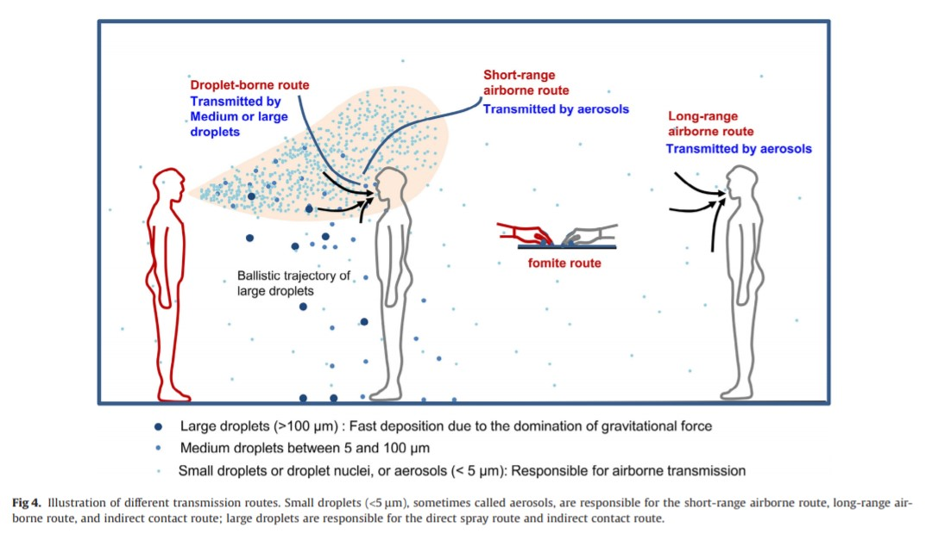
https://www.ajicjournal.org/article/S0196-6553(16)30531-4/pdf

Slide 16
Seasonality and Mutation Rate
We don’t know.
Some CoV are seasonal in northern hemisphere; MERS is not.
High disease burden and outbreaks obscure seasonality.
Typical viral mutation rate; see NextStrain for real time gene sequencing: https://nextstrain.org/
Major strain development: L type (more virulent) and S type (wild type/apparent first strain). Lethality difference unclear.
Normally viruses become more benign over time. However, delayed symptom onset, delayed time to death, poor access to diagnosis with isolation, contact tracing and quarantine makes deadly strains persist.

Slide 17
Symptoms and Disease Course
Week 1: Fever (77-98%) (intermittent or persistent), Fatigue/Malaise (11-52%), Dry cough (46-82%), dyspnea (3-31%);
Less common: Sputum (33%), Myalgia (15%), Headache (13%), Sore throat (14%), Diarrhea (4%), Nausea/Vomiting (5%), Nasal congestion (4%), Hemoptysis (1%)
Week 2 (~ day 6-9 of symptoms): ~ 15-20% develop severe dyspnea due to viral pneumonia
Hospitalization, supportive care, oxygen
Week 2-3: Of hospitalized patients, 1/3 ultimately need ICU care, with up to half needing intubation (i.e. ~5% of total diagnosed cases need ICU)
Can rapidly decline (over 12-24 hrs) from mild hypoxia to frank ARDS
Cytokine Storm, Multi-organ failure
Late stage sudden cardiomyopathy/viral myocarditis, cardiac shock

Slide 18
Cormorbidities and Risk Conditions
Age
HTN
Diabetes
Coronary Heart Disease
Hep B
Cerebrovascular Disease
COPD
Cancer
Children and pregnant women seem to do okay

Slide 19
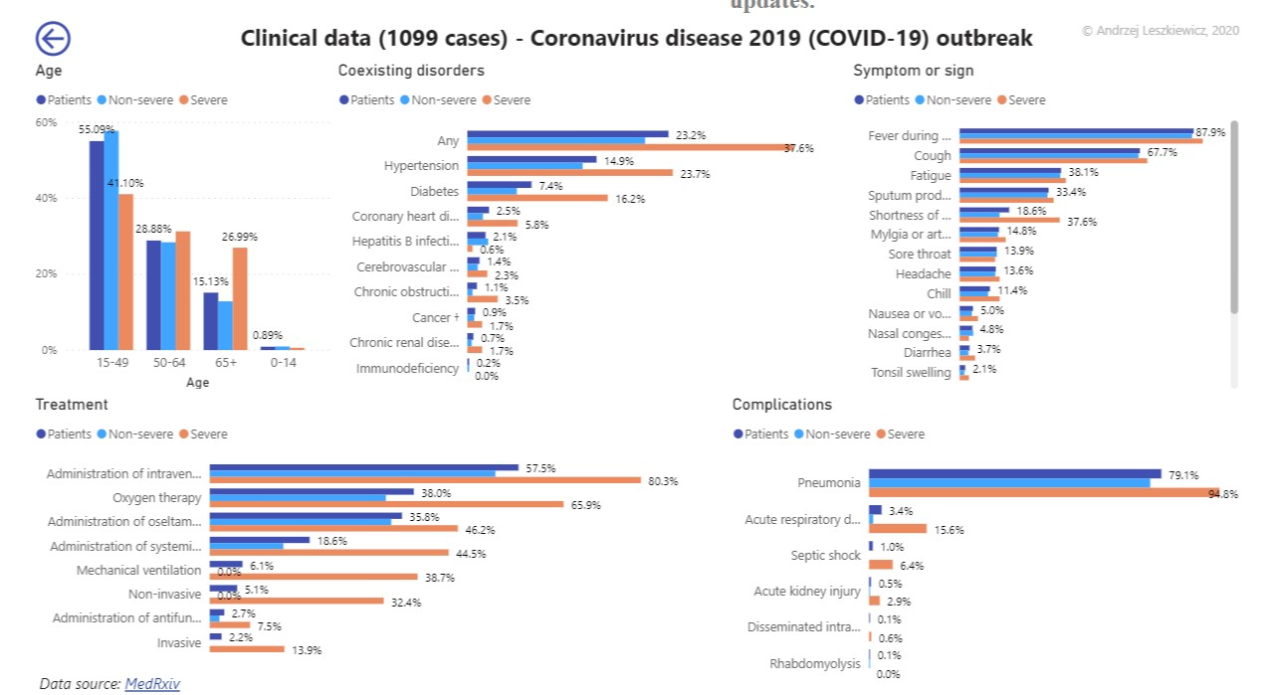
https://avatorl.org/covid-19/?page=ClinicalData1099

Slide 20
Diagnosis
Travel History, Exposure and Symptoms most important
Person Under Investigation Criteria
No specific physical exam findings. Lungs may have rales or rhonchi.
Hypoxia, even silent hypoxia, may be present, esp elders.
Tachycardia and tachypnea.
May present as severe asthma or COPD exacerbation.

Slide 21
Ancillary Studies
Most Common:
WBC usually normal, Lymphopenia in 80%, Mild thrombocytopenia
Low Procal; Bacterial coinfection rare
CRP and D-Dimer elevated proportionate to severity (marker of poor prognosis); DIC over time
Increased ALT/AST to 70-100 range; Occasional increased alk phos
Mild elevation of creatinine
Generally normal troponin
CXR (sensitivity 59%):
Bilateral patchy or reticular infiltrates, perihilar infiltrates occasionally
CT scan (sensitivity 86%; much better than RT-PCR!)
Bilateral diffuse ground glass opacities, multifocal patchy consolidation, interstitial changes
Changes prior to severe symptom onset!
ECHO:
Normal EF prior to late-onset sudden cardiogenic shock with dropping to EF <10%
Co-infection rare but possible (5%)

Slide 22
Person Under Investigation (PUI)
Clinicians should use their judgment. Most patients with COVID-19 have fever and/or cough or difficulty breathing.
Priority may be given to:
Hospitalized patients who have signs and symptoms compatible with COVID-19 in order to inform decisions related to infection control precautions.
Symptomatic patients such as, older adults and individuals with chronic medical conditions and/or an immunocompromised state (e.g., diabetes, heart disease, receiving immunosuppressive medications, chronic lung disease, chronic kidney disease).
Any persons including healthcare personnel, who within 14 days of symptom onset had close contact with a suspect or laboratory-confirmed COVID-19 patient, or who have a history of travel from affected geographic areas within 14 days of their symptom onset.

Slide 23
Person Under Investigation (PUI)
Close contact is defined as—
a) being within approximately 6 feet (2 meters) of a COVID-19 case for a prolonged period of time; close contact can occur while caring for, living with, visiting, or sharing a healthcare waiting area or room with a COVID-19 case
– or –
b) having direct contact with infectious secretions of a COVID-19 case (e.g., being coughed on)
If such contact occurs while not wearing recommended personal protective equipment or PPE (e.g., gowns, gloves, NIOSH-certified disposable N95 respirator, eye protection), criteria for PUI consideration are met.

Slide 24
Myth 4: Respiratory Viral Panel tests for this
Generally, RVP tests for: Adenovirus, Coronavirus 229E, Coronavirus HKU1, Coronavirus NL63, Coronavirus OC43, Human metapneumovirus, Human rhinovirus/enterovirus, Influenza A, subtypes 2009H1N1, H1, H3, Influenza B, Parainfluenza virus types 1, 2, 3 and 4, Respiratory Syncytial Virus.
Chlamydophila pneumoniae, Mycoplasma pneumoniae, Bordetella Pertussis in some labs.
It does NOT test for COVID-19 (or SARS or MERS)

Slide 25
Testing
RT-PCR:
Real-time Polymerase Chain Reaction of RNA
Nasal AND Orophangeal Swabs (Collect 2 swabs)
Sputum better (but more dangerous to collect?)
Stool – not generally used for testing
Blood or urine – virus not detected; blood could be tested for IgM, IgG later. DO get (bacterial) blood cultures for any sick patient.
PCR ~ 60-80% sensitive
A single negative RT-PCR doesn't exclude COVID-19 (especially if obtained from a nasopharyngeal source or relatively early in the disease course).
If RT-PCR is negative but suspicion remains, consider ongoing isolation and re-sampling several days later.
Sensitivity from private labs may vary; no data yet. Also dependent on collection technique and timing – early test on asymptomatic may not be accurate

Slide 26
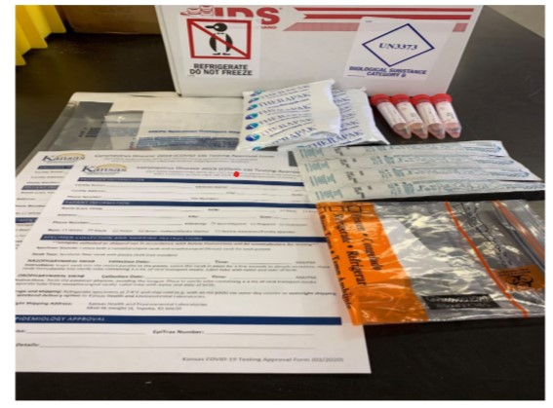
Testing “Kits”
1 Cold shipper w/ Refrigerate and Category B labels
2 Ice packs
2 – 3 mL Vials of viral transport media (VTM)
2 Nasopharyngeal Swabs
The swabs CANNOT be of cotton or wooden shaft
Only synthetic fiber swabs with plastic/aluminum shafts
1 Zip-close biohazard bag
1 95 kPa bags
2 Coronavirus Disease 2019 (COVID-19) Testing Approval Forms

Slide 27
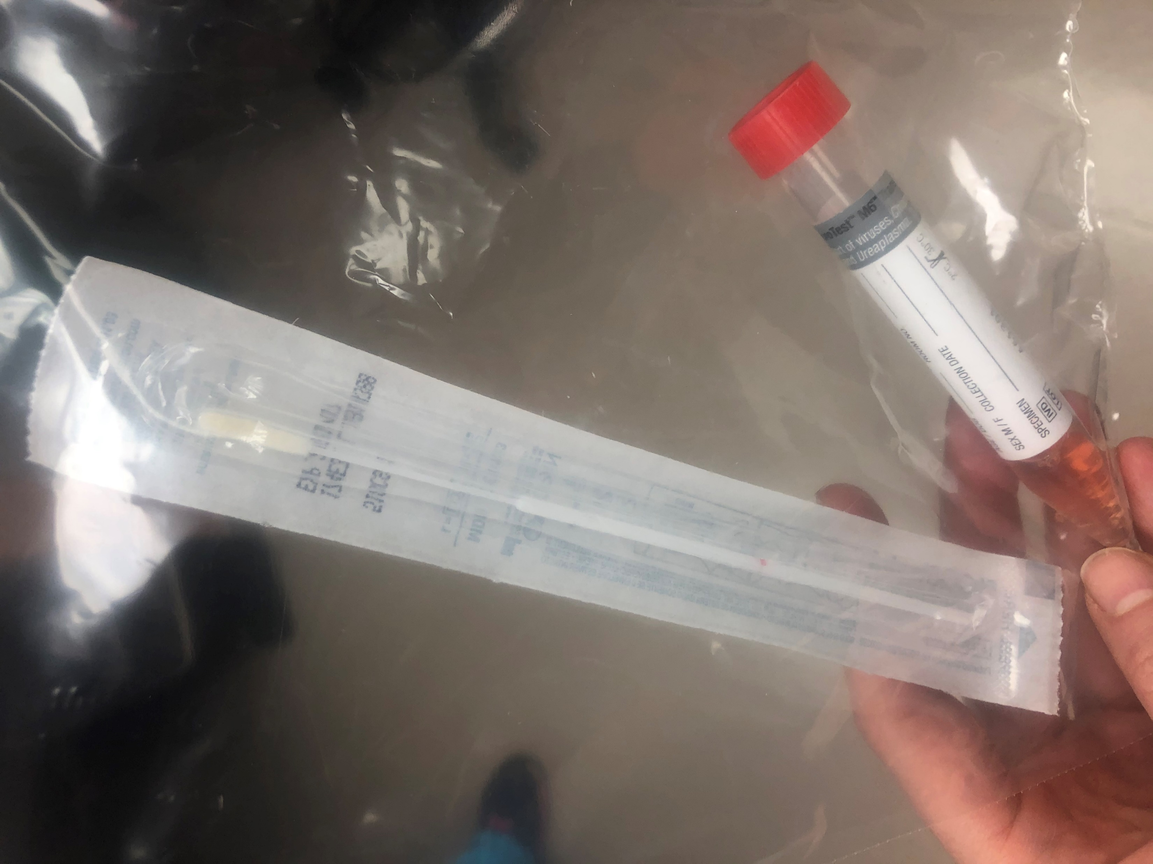
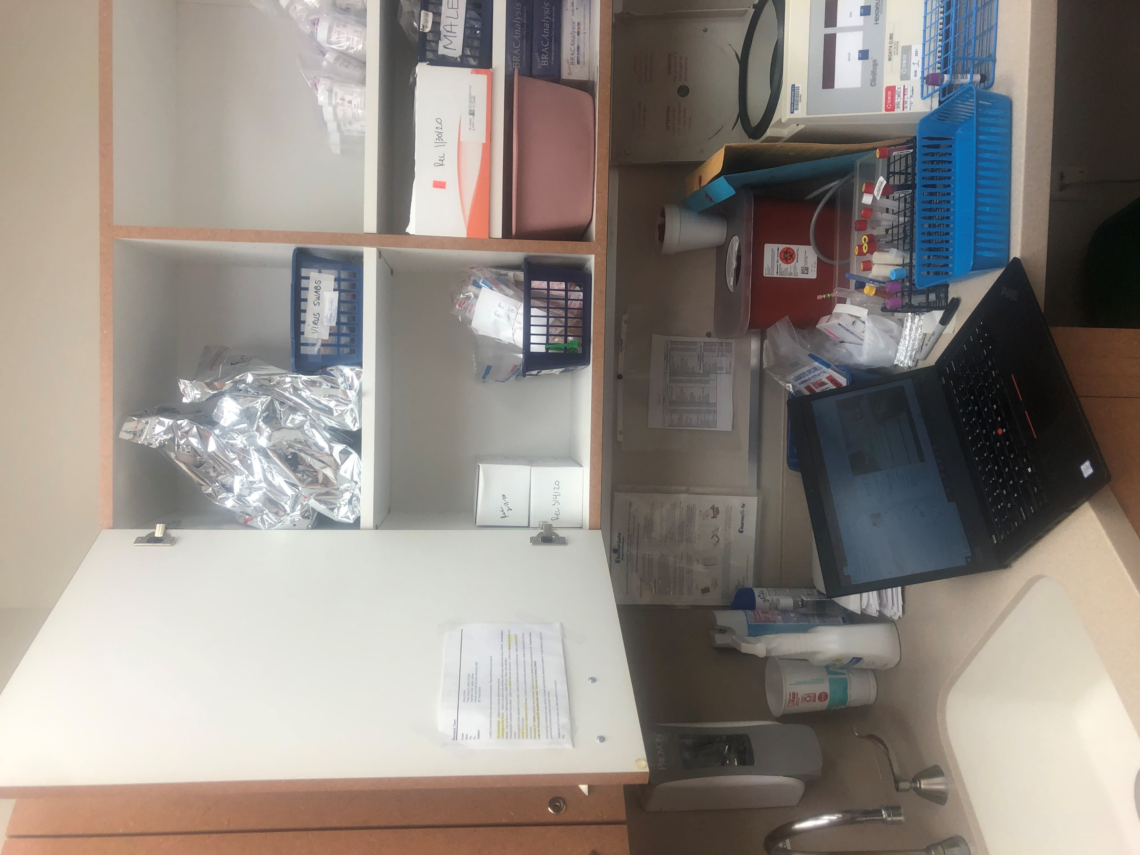
Outpatient Testing Supplies
Triage by phone or at door to Ascension urgent care. Try to keep patients in car or outside.
If patient seen in clinic and needs unexpected testing, put mask on patient, wash hands, leave room.
Confirm with preceptor.
Go to lab for 2 swabs and biohazard bag.
Don PPE: gown, gloves, surgical mask or n95, faceshield
Test outside or in car (respect patient privacy).
Place in biohazard lab.
Lab will place on ice and call St Francis for STAT pick-up.
Patient home on isolation (see CDC guidelines).
Clean stethoscope, room, etc.

Slide 28
How to collect
How to collect a nasopharyngeal swab
https://www.youtube.com/watch?v=DVJNWefmHjE#action=share
How to collect an oropharyngeal swab
https://www.youtube.com/watch?v=sYWYEAURUl8
Nasopharyngeal AND Oropharyngeal swabs, as separate swabs.
If you don’t collect a good sample, it’s a waste of an expensive test and falsely negative!
Collect sputum only if patient has productive cough (do not induce cough)
Bronchoalveolar lavage is also high risk to healthcare workers.
If intubated, collect tracheal aspirate.
https://www.cdc.gov/urdo/downloads/SpecCollectionGuidelines.pdf

Slide 29
Treatment
Mild/moderate symptoms (80%)
Outpatient management of symptoms and isolation
OTC Tylenol, cough and cold medications
Avoid steroids (ICS or oral/IM) unless compelling need (COPD or Asthma Exac)
Possibly avoid ACEI or Ibuprofen – data unclear!
Need to protect family members! (Check CDC guidelines)
At least 2 weeks isolation?
Unclear when viral shedding no longer present.
Unclear if we will require two negative tests and/or begin testing IgM IgG

Slide 30
Treatment
Moderate with risks/severe/critical symptoms (15-20%)
Inpatient management and supportive care
Obtain Advanced Directives! Offer Chaplain Support for high risk patients.
Oxygen by NC (place surgical face mask over NC to reduce aerosolization?)
Anticipate rapid progression to High Flow/NRB
Avoid NIV/BiPAP/Bronchoscopy if possible (increased aerosolization -> risk to others!)
ARDS: Controlled early intubation with airway pressure release ventilation (APRV), Paralysis, Prone positioning, Flolan. Tight connections of ETT and tubing.
Avoid fluid blousing, sepsis protocol bolusing. NG tube for feeds (ARDS takes time to resolve)
Daily labs: Renal, Mag, CBC with diff, DIC labs, ?LFTs, ?ABG (permissive hypercapnia if needed)

Slide 31
Treatment
Moderate with risks/severe/critical symptoms (15-20%)
BiPAP increases risk of areolation due to positive pressure (as would CPAP), AND generally patients needing BiPAP end up needing intubation.
Patients do worse on BiPAP compared to HFNC/NRB.
If BiPAP is the ONLY option (no vents) or is needed due to COPD, negative pressure room, air filtration, helmet interface.

Slide 32
Treatment
Moderate with risks/severe/critical symptoms (15-20%)
Antibiotics, Antifungal probably not helpful (RARE secondary infections)
Procal and cultures can guide – discontinue at 48 hours
Watch for HAP/VAP
Steroid could: 1. increase viral levels, shedding time, lung damage -> ? increase mortality 2. reduce pathological hyper-immune response (beneficial for ARDS)
At least NOT high dose pulsed steroids (not Solumedrol or Hydrocortisone)
Cardiac: Watch for late onset cardiomyopathy (? Viral myocarditis) with sudden EF <10% leading to cardiogenic shock
Be careful if coding patients – high risk to you, low chance of survival
See https://emcrit.org/ibcc/COVID19/ for more critical care management!

Slide 33
Experimental Treatment & Vaccine
Experimental:
Lopinavir/Ritonavir (Kaletra – protease inhibitors)
Ribavirin
Remdesivir
Chloroquine/hydroxychloroquine
High dose IV Vitamin C
IVIG
Serum antibodies of recovered patients
Some Vaccine trials in Phase 1 Clinical Trials

Slide 34
“EVERYTHING WE DO BEFORE A PANDEMIC WILL SEEM ALARMIST. EVERYTHING WE DO AFTER WILL SEEM INADEQUATE”
~ Michael Leavitt

Slide 35
Epidemiology
“the branch of medicine which deals with the incidence, distribution, and possible control of diseases and other factors relating to health.”
Incidence
Prevalence
R0 and R
Case Fatality Rate
Mortality Rate
Prevention
Containment
Mitigation
Infection, Prevention and Control (IPC)

Slide 36
Epidemiology
Outbreak: “more disease than would be expected”
e.g. measles outbreaks
Endemic: “diseases that remain in an area naturally”
Outbreaks can also occur in endemic areas
Endemic diseases can be exported to other places, causing outbreaks
Public Health Emergency of International Concern (PHEIC):
WHO declares if it 1. constitutes a public health risk to other States 2. potentially requires a coordinated international response
Emergency Committee established, unlocks funding, supplies and international response
Can also increase stigma, xenophobia, economic harm (tourism) to affected country
Epidemic: “regional outbreak of a disease that spreads suddenly and unexpectedly”
Pandemic: “worldwide, often rapid, spread of a disease”
WHO declares and has implications for activation of worldwide response, national response, World Bank funding, etc.

Slide 37
Basic Reproduction Number (R₀)
“Number of cases directly generated by one case in completely susceptible population without interventions”
Effective Reproduction Number (R): “number of cases generated by one case with interventions/immunity”
Some individuals immunized or already infected/recovered
Nonpharmaceutical Interventions (NPI) implemented (social distancing, quarantines, isolation, treatment)

Slide 38
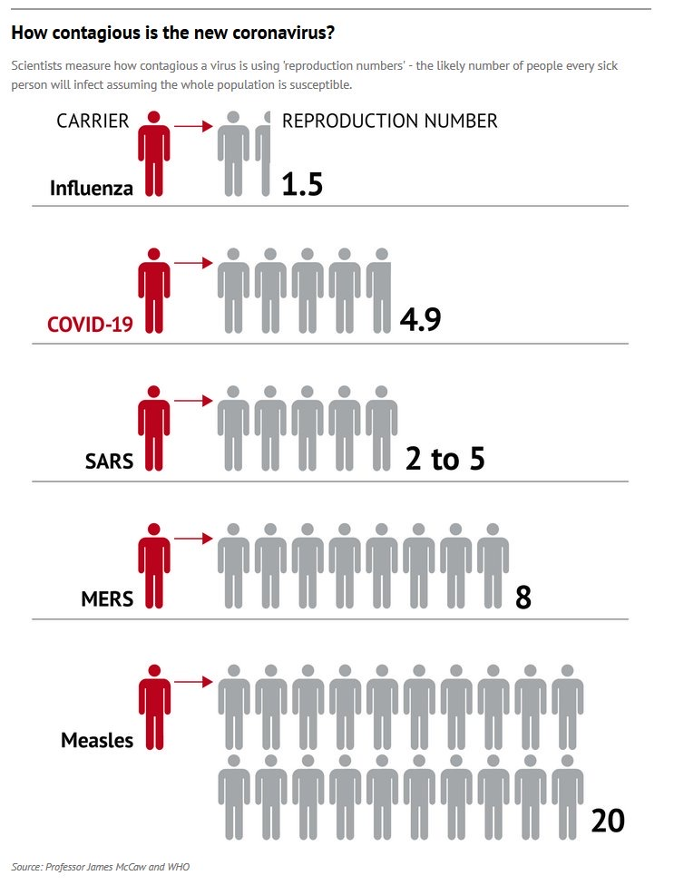
Typically cited as 2-3 but may be as high as 4.9; varies by population density and exposure patterns
Probably about twice as transmissible as influenza

Slide 39
Case Fatality Rate
Case fatality rate/risk/ratio (CFR) is the ratio of deaths from a certain disease to the total number of people diagnosed with this disease for a certain period of time
Deaths/Total Cases = CFR
During epidemics, CFR often initially over-estimated as predominantly testing cases that are sicker in hospital (numerator); then CFR is under-estimated as increase testing of mild cases (denominator) that have not yet resolved (recovered or died)
Longer time to resolution or death can make CFR look better than it really is until final outcome

Slide 40
Mortality Rate
Mortality rate (death rate): Number of deaths in general or due to specific cause in particular population per unit of time.
e.g. mortality rate of influenza per week is total deaths related to influenza
Epidemic threshold: level of incidence (of disease or of death) above which an urgent response is needed; varies by disease.
e.g. For influenza, if the mortality rate >7.3% that is, by definition, an epidemic. Once it drops below that, it is no longer epidemic. CFR is 0.1% but the mortality rate per week in the hospital will rise and fall.

Slide 41
Case Fatality rate
COVID-19: 0.7 to 3.4% (>5% in Wuhan itself during peak)
Will be higher without access to healthcare, oxygen and ventilators
Spanish Influenza 1918: >2.5% Mostly younger people
Seasonal Influenza: 0.1-0.2%

Slide 42
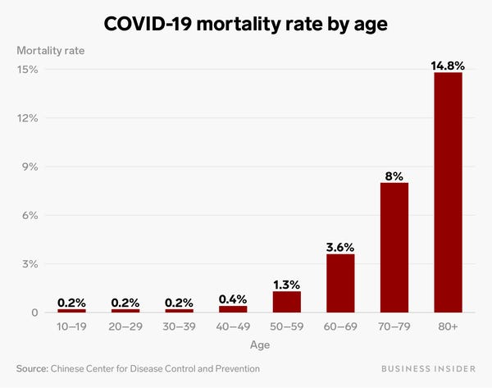
CFR with Comorbidities: 10.5% cardiovascular disease, 7% diabetes, 6% each for chronic respiratory disease, hypertension, and cancer. Case fatality for patients who developed respiratory failure, septic shock, or multiple organ dysfunction was 49%.

Slide 43
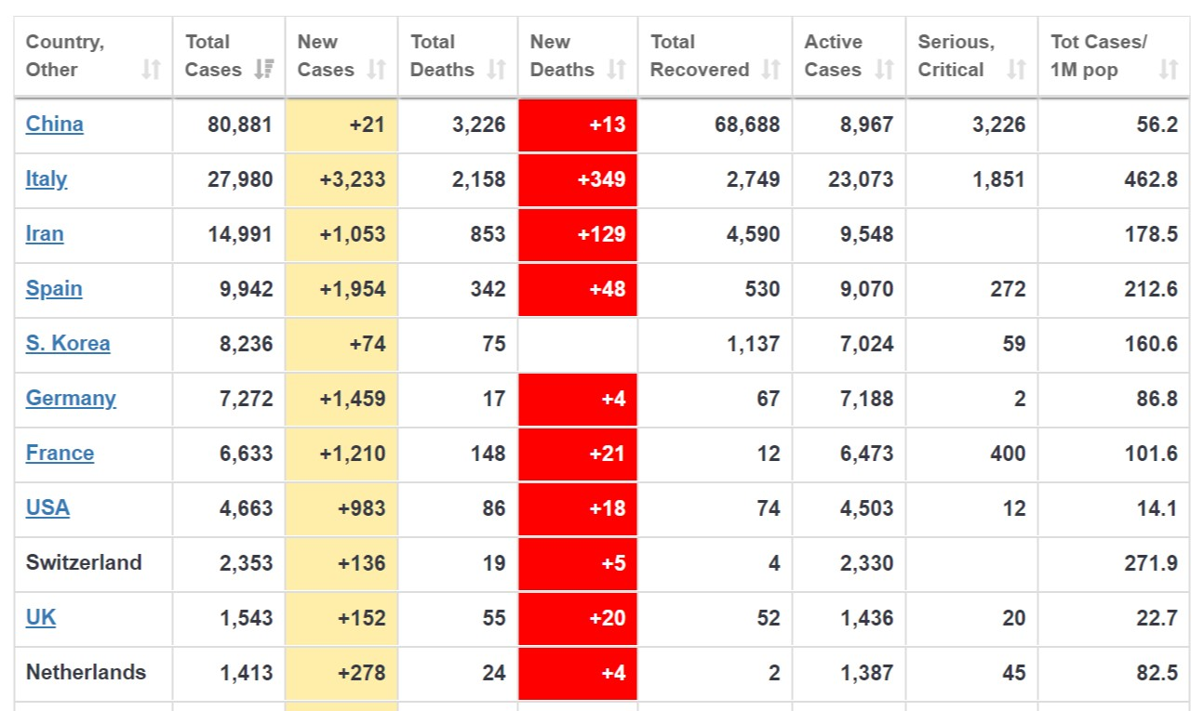
Current CFR 3.9 and thoughts about range
CFR
4.0
7.7
5.7
3.4
0.9
0.2
3.6
1.8
1.7
3.5
1.6
China: More recovered than active cases
Iran and Italy: Overwhelmed with sicker and older patients, Less community testing;
S Korea: Rapid population testing of contacts; not enough time for +ve deaths/recovered
Germany: Young patients diagnosed, aggressive testing
But both S Korea, Germany rising slowly.
US: Decreasing as more testing, but not at capacity of healthcare system

Slide 44
COVID-19 Stats Summary
Median age affected - 50
Deaths: slightly more Males > Females
Kids and pregnant women seem to do okay
Of total cases
80% mild/moderate
15-20% are severe/critical
2.5 - 10% require ventilator
CFR = 0.7% to 7.7%
R0 = 2-5

Slide 45
Possible estimates by Dr Lawler at American Hospital Association meeting
R0: 2.5; Doubling time 7-10 days (Influenza: 1.4)
Community attack rate 30-40% = 96 million (5-20%; 45 million)
Cases requiring hospitalization 5% = 4.8 million (810,000)
Cases requiring ICU 1-2% = 1.9 million (96,000)
Cases requiring vents 1% = 1 million
CFR 0.5% = US 488,000 deaths (0.1%; 50,000)
“Prepare for 10X seasonal influenza burden”
James Lawler, MD, MPH
Director, International Programs and Innovation, Global Center for Health Security Director, Clinical and Biodefense Research, National Strategic Research Institute

Slide 46
Underestimation?
R0: 2.5; doubling time 7-10 days
Community attack rate 30-40% = 96 million
Cases requiring hospitalization 5% = 4.8 million
Cases requiring ICU 1-2% = 1.9 million
Cases requiring vents 1% = 1 million
CFR 0.5% = US 488,000 deaths

Slide 47
Harvard Epidemiologist (Dr Lipsitch) + current disease ratios
R0 = 2.5 (R could be lowered with mitigation efforts) (Influenza has vaccine)
Doubling time = 6-7 days (could be extended with mitigation)
Community attack rate 40-70% = 131-229 million (5-20%; 45 million)
Cases requiring hospitalization 15% = 20- 34 million (2% or 810,000)
Cases requiring ICU 5% = 6.5 – 11.4 million (96,000)
Cases requiring vents 2.5% = 3.25 – 5.7 million
CFR 1-2% = 1.3 – 5 million deaths (0.1% or 50,000)
https://www.cbsnews.com/news/coronavirus-infection-outbreak-worldwide-virus-expert-warning-today-2020-03-02/

Slide 48
US Surge Capacity Challenges
Total hospitalizations per year: 34 million (including influenza)
Hospital beds (2015): ~ 540,668 staffed beds, of which 94,837 ICU beds (of which 4698 dedicated pediatric ICU, 22,330 neonatal ICU); Per CDC Dr Fauci, 45,000 available ICU beds.
Average occupancy: 64-68%
Ventilators: ~ 62,188 full-feature mechanical ventilators; 98,738 devices other than full-feature ventilators – BiPAP; some in operating rooms too.
20-40% ICU patients typically need vent support
3.25 – 5.7 million patients need vents for COVID-19
On vent for 2-4 weeks
Some would be same patients who would otherwise be hospitalized for other comorbidities.
https://www.ncbi.nlm.nih.gov/pubmed/21149215
https://www.sccm.org/Communications/Critical-Care-Statistics

Slide 49
Kansas Capacity
11,345 licensed acute care beds of which 8766 staffed beds
1111 nursing home beds
292,953 admissions annually
Predictions for COVID-19, based on Harvard and current data:
Population: 2.912 million Kansans
Community attack rate (40-70%): 1.164-2.038 million
Hospital admission (15%): 174,600 - 305,700
Potential Deaths (1-2%): 29,120 – 58,240 (Influenza in Kansas annually only 1438)
This assumes access to hospital care/healthcare workers/oxygen/vents
https://www.kha-net.org/DataProductsandServices/STAT/HospitalUtilization/
http://www.kdheks.gov/flu/surveillance.htm

Slide 50
Management of Epidemic
Prevention!
Safe public health practices – vaccines, WASH (water, sanitation and hygiene) and IPC (Infection Prevention and Control) measures, Universal Precautions
Surveillance systems of WHO, CDC/Ministry of Health, Public/Community Health
Containment:
Isolation of sick persons, Contact Tracing, Quarantine of exposed persons
Mitigation: Nonpharmaceutical interventions
Personal – Hand hygiene, Cover cough, Stayi away from sick persons, Avoid Face
Social – Social distancing, Canceling mass gatherings/non-essential activities
Environmental – Cleaning measures

Slide 51
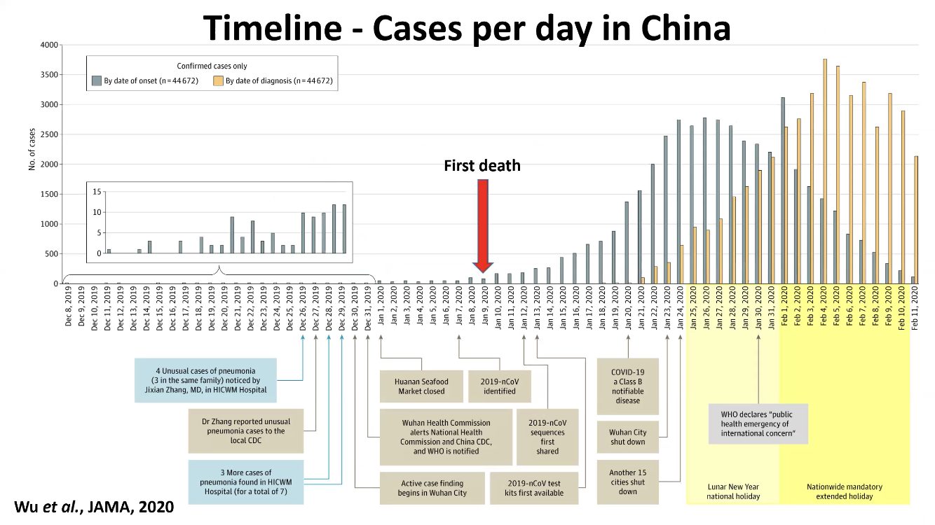

Slide 52
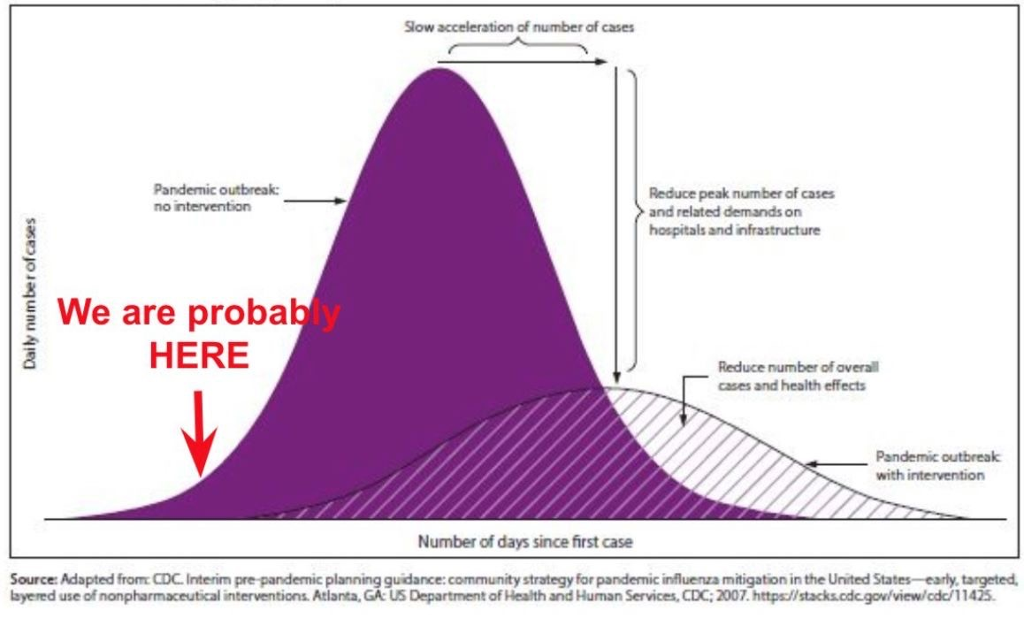
We MUST #FlattenTheCurve

Slide 53
Quarantine vs Isolation
Quarantine: To separate and restrict movement of well persons who may have been exposed Monitor to see if they become ill | Isolation: To separate ill persons who have a communicable disease Restrict movement

Slide 54
Federal Quarantine Authority
Authority to “prevent the transmission, introduction, or spread of communicable diseases”
Statutory authority for HHS to govern questions of isolation and quarantine, HHS regulations give operational oversight to CDC
Covers interstate and foreign quarantine rules
List of diseases: Cholera, Diphtheria, Infectious Tuberculosis, Plague, Smallpox, Yellow Fever, Viral Hemorrhagic Fevers, Severe acute respiratory syndromes, Influenza caused by novel or re-emergent influenza viruses that are causing/have potential to cause a pandemic

Slide 55
State Quarantine Authority
Most frequently utilized
Can be voluntary or involuntary
Laws and processes differ across states
Diseases that may qualify for quarantine/isolation differ across states

Slide 56
Home Isolation
The patient is stable enough to receive care at home.
Separate bedroom (bathroom recommended), access to food and other necessities. Appropriate caregivers.
The patient and other household members must have access to PPE (minimum gloves and facemask) and are capable of adhering to precautions (e.g., respiratory hygiene, cough etiquette, hand hygiene);
Consider at-risk populations in home (people >65 years old, young children, pregnant women, immunocompromised, chronic heart, lung, or kidney Dx).
Provide Guidance for Precautions to Implement during Home Care
A healthcare professional should
Provide CDC’s Interim Guidance for Preventing Coronavirus Disease 2019 (COVID-19) from Spreading to Others in Homes and Communities to the patient, caregiver, and household members; and
Contact their state or local health department to discuss criteria for discontinuing any such measures. Check available hours when contacting local health departments.

Slide 57
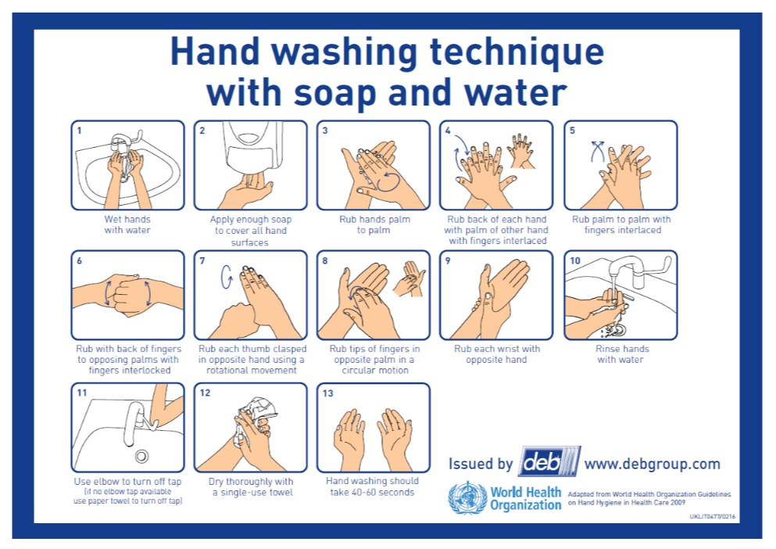

Slide 58
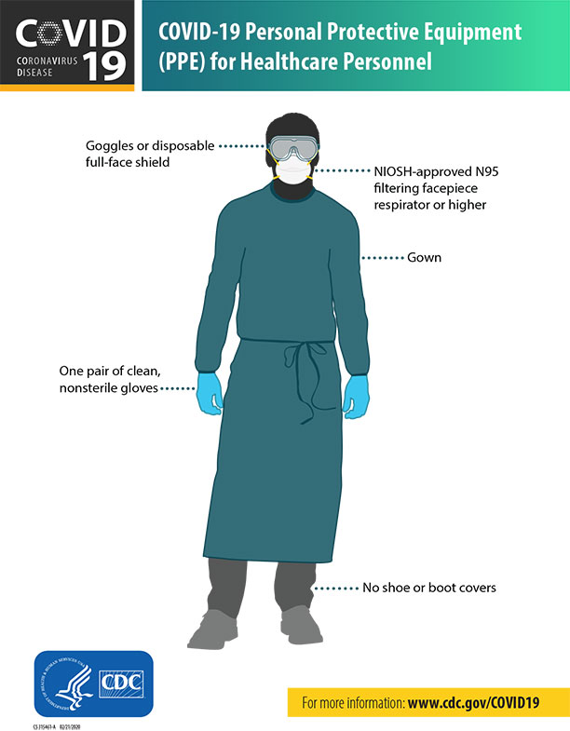
CDC recommendations
Doffing technique is even more important than donning!
Info and Videos available on CDC
Surgical Mask if no N95 and for regular exposure
https://infectioncontrol.ucsfmedicalcenter.org/covid/donning-and-doffing-novel-coronavirus-covid-19-videos

Slide 59
Masks and NIOSH Standard Respirators
Simple and Surgical masks:
NOT a Filter, but stops DROPLETS
Recommended for PATIENTS who are coughing and/or if YOU are in close proximity to fluids
DON’T touch/adjust it! Stop pulling it down to your neck between patients! Stop putting on countertops! DON’T stick it in your white coat! (STOP WEARING WHITE COATS!)
Respirators: N95 means >95% of particles/pathogens down to 0.3 microns are filters
N = not oil resistant
R = mildly oil resistant
P = oil resistant (for organic chemical poisoning protection)
There are also N99 and N100 and P99 and P100 masks
Fit is important!
Air valve can help with heat/moisture
PAPRs and CAPRs: Powered Air Purifying Respirators, Controlled Air Purifying Respirators

Slide 60
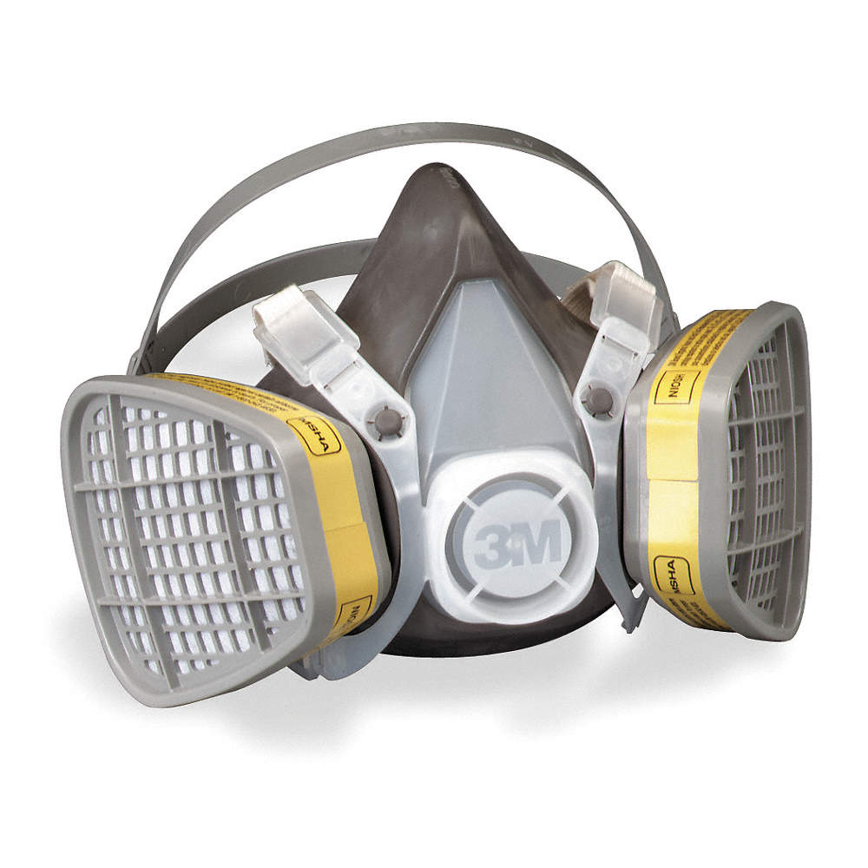
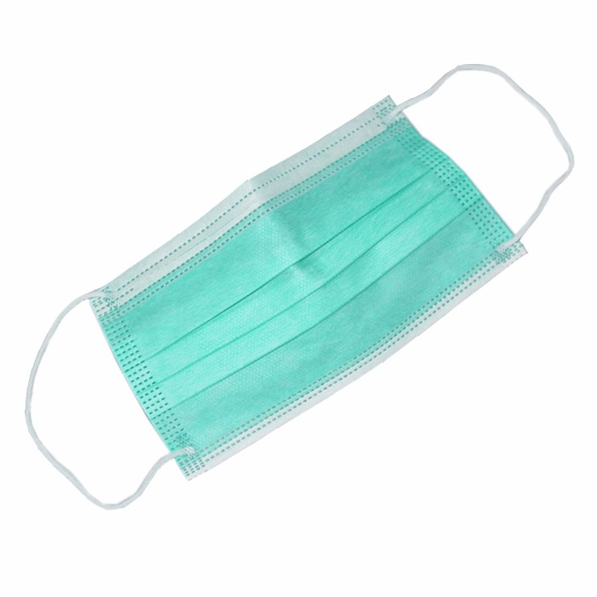
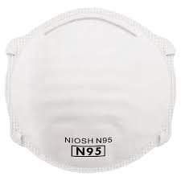
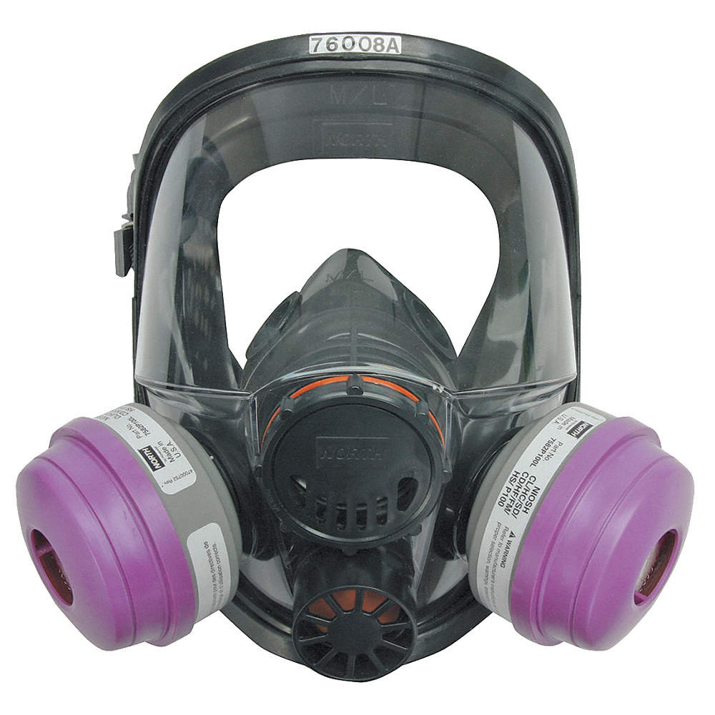
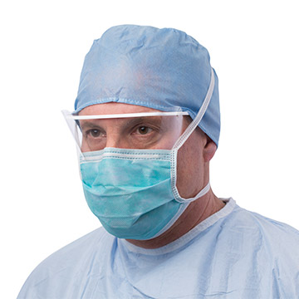
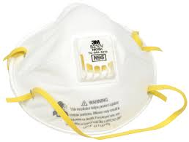
https://jamanetwork.com/journals/jama/fullarticle/2762694
https://candid.technology/n95-vs-n99-vs-p95-comparison/

Slide 61
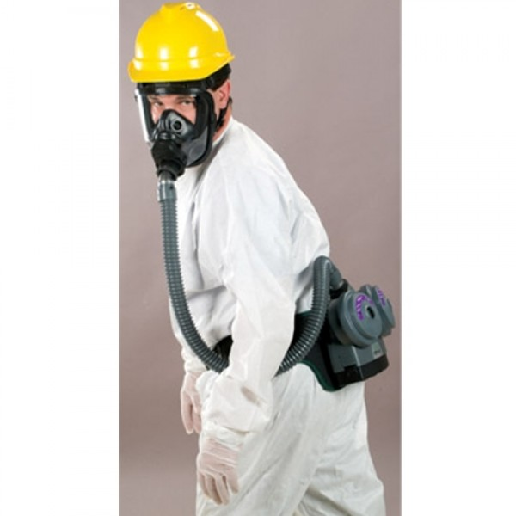
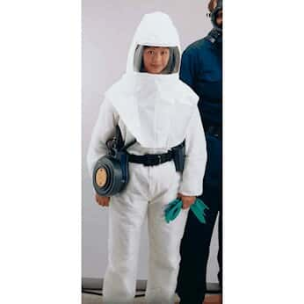
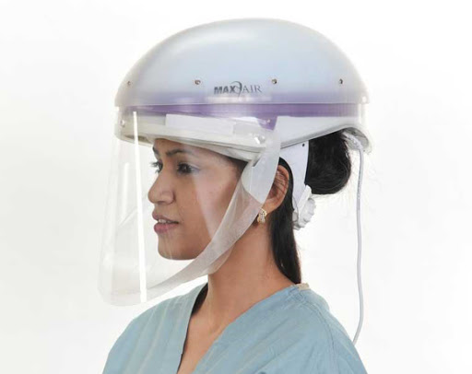

Slide 62
Healthcare Chain of Command & Task Force
Military services: Surgeon General Gerome Adams
HHS: Secretary Alex Azar
CDC (Center for Disease Control): Robert Redfield; Nancy Messimore
NIH (National Institute of Allergy and Infectious Diseases): Anthony Fauci
CMS (Center for Medicare/Medicaid Services): Seema Verma (admin)
FDA (Federal Drug Administration): Stephen Hahn
States have Public Health Departments that report data to CDC
County Public Health Departments report to State

Slide 63
Planning Ahead
Triage protocols, phone scripting, to direct to specific Urgent Care
Masks and Hand Sanitizer at front desk
Sterilizing doors, counters, rooms, handles after every visit
Telemedicine for minor acute care, chronic care
Cancelling non-essential surgeries, procedures, visits
Well women; KBHs without need of vaccines; Sports medicine
Ethical protocols for triage of resources:
e.g. SOFA/APACHE 2 score + D-Dimer + CRP? Age + Comorbities? Unclear.
Mental Health – please please please reach out if you need help. We are all in this together.

Slide 64
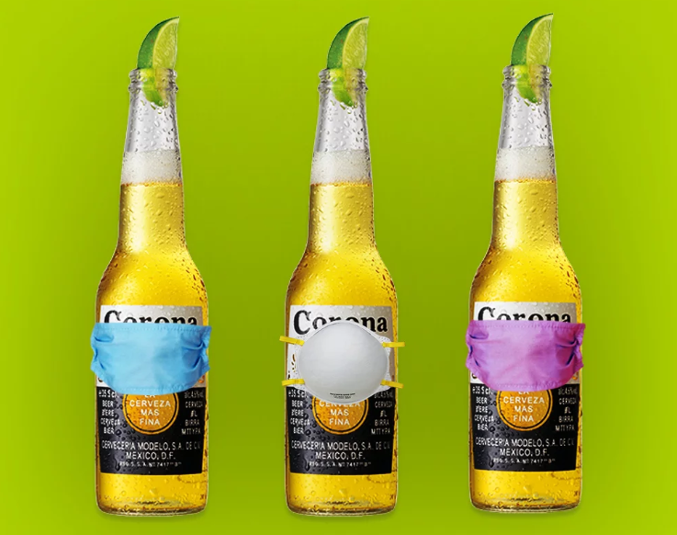
Myth 5: Coronavirus comes from Beer
Nope! Enjoy!

Slide 65
References (if not otherwise indicated)
https://emcrit.org/ibcc/COVID19/
UpToDate on Coronaviruses, SARS, MERS, COVID-19
CDC: https://www.cdc.gov/coronavirus/2019-ncov/index.html
WHO: https://www.who.int/health-topics/coronavirus
Online courses at: https://openwho.org/
https://www.worldometers.info/coronavirus/
https://coronavirus.1point3acres.com/en?fbclid=IwAR3A3clE1Ztxi-fNBgTWtVOobWuUBGFJ1S3NBPFlAaYVruBcAtzeOcqpIjQ
Dr James Lawler Presentation at American Hospital Association/ National Ebola Training and Education Center

Slide 66

Isenheim Altarpiece commissioned in 1512 during a plague to comfort sufferers

